Slide 1



OPOSEC
OSINT
PRIVATE BUSINESS, PUBLIC FALLOUT
Private Business, Public Fallout
How OSINT Took Down Portugal's Government
Abstract: This talk outlines a step-by-step guide to leveraging open-source intelligence (OSINT) to uncover the publicly available information that fueled a scandal involving a Portuguese prime minister, ultimately leading to the collapse of the government. Using real-world techniques, we’ll explore how private business dealings became a public crisis, demonstrating the power of OSINT in exposing hidden connections.
Notes:
This presentation sets the stage for understanding how open-source intelligence (OSINT) played a pivotal role in a significant political scandal in Portugal. By examining the steps taken to gather publicly available information, we can appreciate how private business dealings can escalate into public crises. The case illustrates the profound impact of OSINT in revealing hidden connections that can lead to governmental collapse, emphasizing the importance of transparency and accountability in both public and private sectors.

Slide 2
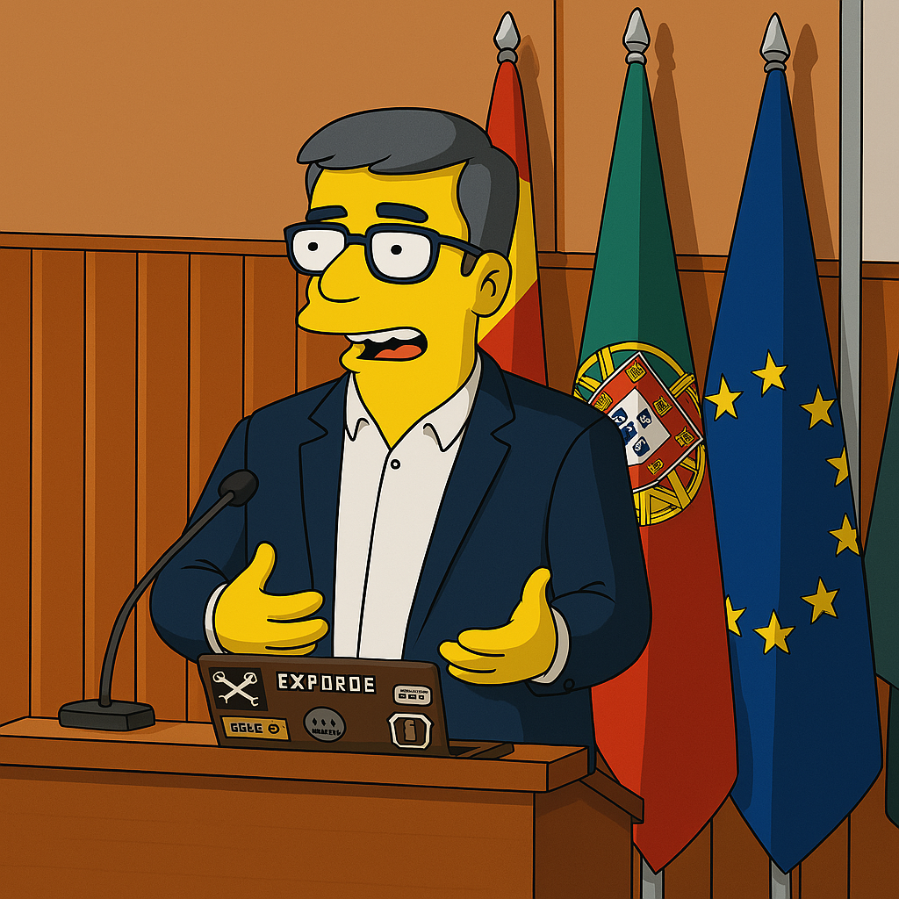
OPOSEC
OSINT
PRIVATE BUSINESS, PUBLIC FALLOUT
$whoami
👓 Pedro Vieira
🔐 Cybersecurity Engineer
🕵️ OSINT
✒️ Full stack developer
👨‍🏫 Public Speaker
Page 2
Notes:
Pedro Vieira, a cybersecurity engineer and OSINT expert. His diverse background as a full-stack developer and public speaker positions him uniquely to discuss the intersection of technology and intelligence gathering. This slide highlights his credentials, establishing his authority on the subject matter and setting the tone for the insights he will share throughout the presentation.

Slide 3




OPOSEC
OSINT
PRIVATE BUSINESS, PUBLIC FALLOUT
Disclaimer & Legal Considerations
Presentation is solely for educational and awareness purposes.
Not a political statement.
Users must check the legality of OSINT tools and methods in their country.
This presentation is not related to my work or employer.
Page 3
Notes:
It's crucial to understand the ethical implications and legal boundaries when gathering information from open sources. This context will help the audience appreciate the responsible use of OSINT techniques in uncovering information without infringing on privacy or legal rights.

Slide 4


OPOSEC
OSINT
PRIVATE BUSINESS, PUBLIC FALLOUT
Disclaimer & Legal Considerations
ARTIFICIAL
INTELLIGENCE
Was used on this presentation
Use available technologies but check facts.
Always check facts.
IA is more than ChatGPT. Grok, Claude, …
Use them all.
Page 4
Notes:
It's crucial to understand the ethical implications and legal boundaries when gathering information from open sources. This context will help the audience appreciate the responsible use of OSINT techniques in uncovering information without infringing on privacy or legal rights.

Slide 5
OPOSEC
OSINT
PRIVATE BUSINESS, PUBLIC FALLOUT
Agenda
OSINT
Prime Minister
Page 5

Slide 6

OPOSEC
OSINT
PRIVATE BUSINESS, PUBLIC FALLOUT
OSINT
Page 6

Slide 7

OPOSEC
OSINT
PRIVATE BUSINESS, PUBLIC FALLOUT
OSINT
Open-source intelligence (OSINT) is the collection and analysis of data gathered from open sources (overt and publicly available sources) to produce actionable intelligence. (Wikipedia)
Gathering information from:
government sites
search engines (Google, …)
social media (Facebook, …)
maps
…
And then extract/relate/infer new information with greater value/potential
Page 7
Notes:
This slide provides a definition of open-source intelligence, emphasizing its role in gathering actionable intelligence from publicly available sources. It highlights various platforms for information collection, such as government websites and social media. Understanding these sources is essential for the audience to grasp how OSINT can be effectively utilized in real-world scenarios.

Slide 8
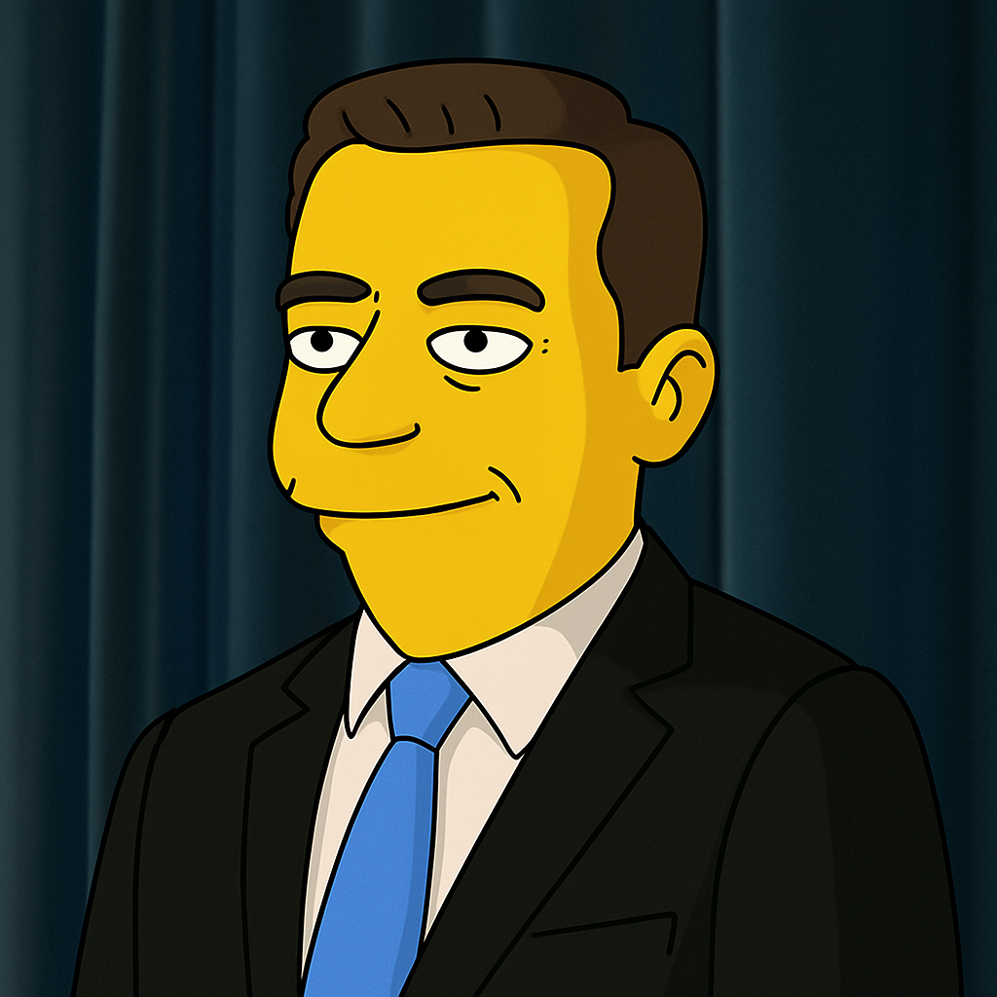
OPOSEC
OSINT
PRIVATE BUSINESS, PUBLIC FALLOUT
Prime Minister
Page 8
Notes:
Here, we focus on the Prime Minister's involvement in the scandal. This slide serves as a transition into discussing specific individuals and their roles in the events that unfolded. By highlighting the Prime Minister, we set the stage for a deeper exploration of the connections and implications of the information gathered through OSINT.

Slide 9
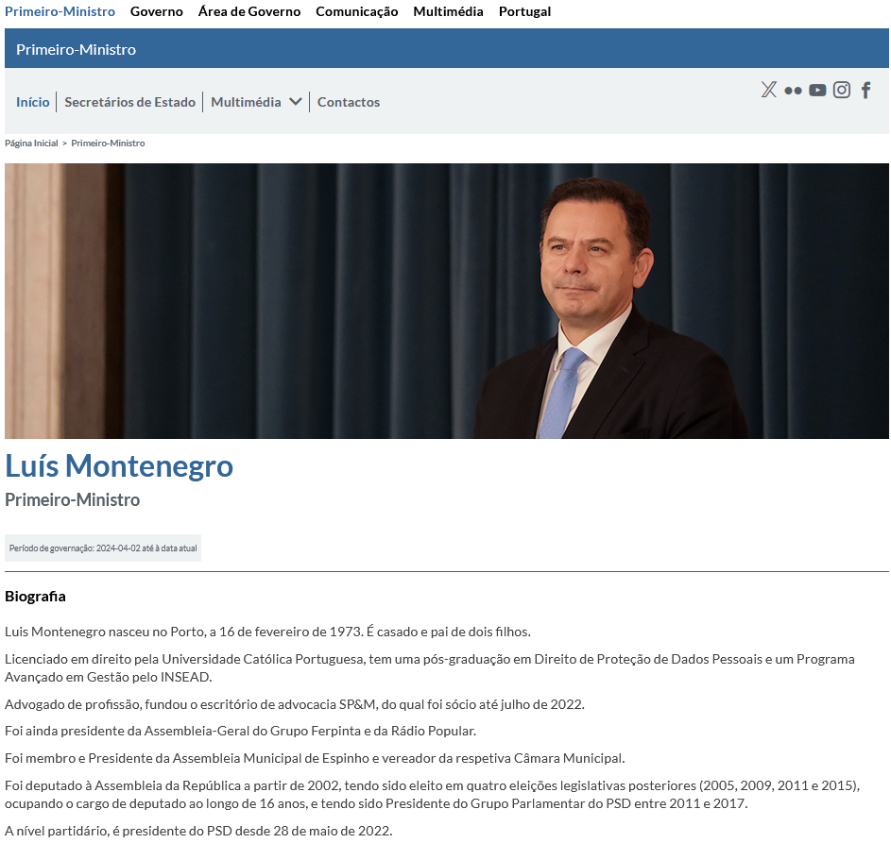
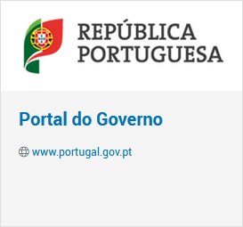
OPOSEC
OSINT
PRIVATE BUSINESS, PUBLIC FALLOUT
Portal do Governo
Page 9
Hint: Prior administrations, officials, ...
Notes:
This slide introduces the 'Portal do Governo,' a key resource for gathering information about government officials and their activities. It hints at the importance of examining prior administrations and officials, which can provide context and background necessary for understanding the current situation. This approach underscores the value of historical data in OSINT investigations.

Slide 10
OPOSEC
OSINT
PRIVATE BUSINESS, PUBLIC FALLOUT
Status
Name: Luís Montenegro
Birth: 16/02/1973 - Porto
Marital Status:
Married
2 children
Education:
Law graduate - Universidade Católica Portuguesa - 1999
Post-graduate degree in Personal Data Protection - INSEAD
Advanced Management Programme - INSEAD
Previous Job:
Lawyer – Founder and Partner of SP&M law firm
Chairman of the General Meeting of the Ferpinta Group
Chairman of the General Meeting of Rádio Popular
Politician:
Member and Chairman of the Espinho Municipal Assembly and Councillor
Member of Parliament in 2002, 2005, 2009, 2011, and 2015 (16 years)
President of the PSD Parliamentary Group from 2011 to 2017
Leader of the Social Democrats (PSD) since 28 May 2022
Page 10
Hint: Every bit of information can lead to more information. Check them all.
Notes:
In this slide, we delve into the background of Luís Montenegro, providing detailed personal and professional information. This data is crucial for understanding his influence and connections within the political landscape. The hint encourages the audience to consider how each piece of information can lead to further insights, reinforcing the investigative nature of OSINT.

Slide 11
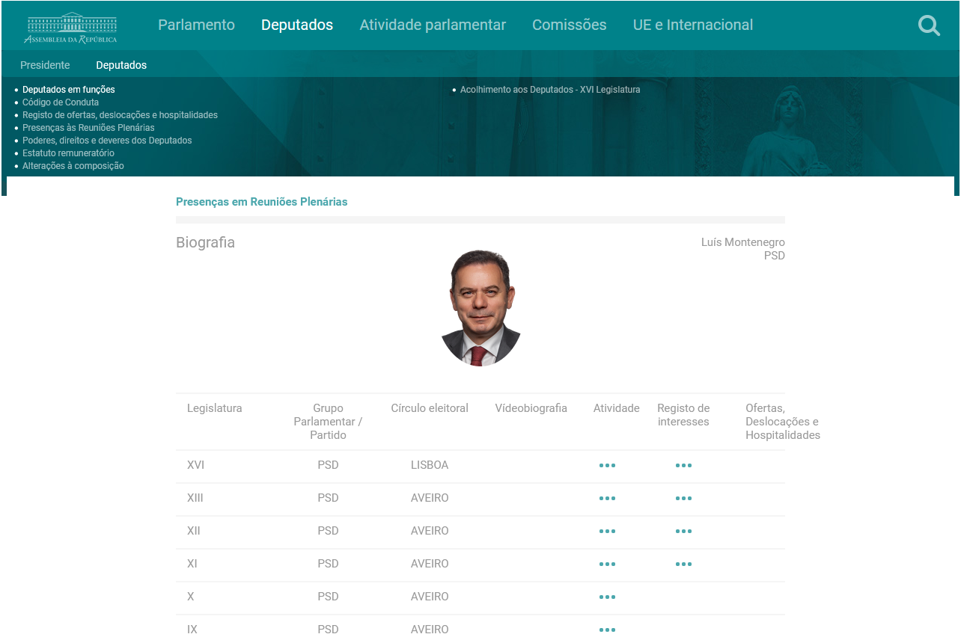
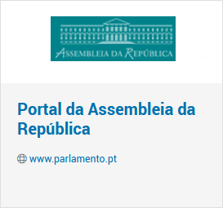
OPOSEC
OSINT
PRIVATE BUSINESS, PUBLIC FALLOUT
Portal da Assembleia da República
Page 11
Hint: Registration of interests
Notes:
This slide highlights the 'Portal da Assembleia da República,' which is essential for tracking the registration of interests among politicians. Understanding these interests can reveal potential conflicts and motivations behind political actions. This resource is vital for anyone looking to conduct thorough OSINT investigations into public officials.

Slide 12
OPOSEC
OSINT
PRIVATE BUSINESS, PUBLIC FALLOUT
Status
Name: Luís Montenegro
Full Name: Luís Filipe Montenegro Cardoso de Morais Esteves
Birth: 16/02/1973 - Porto
Marital Status:
Married - Carla Maria Rodrigues Neto Montenegro
Comunhão de Adquiridos
2 children
Education:
Law graduate - Universidade Católica Portuguesa - 1999
Post-graduate degree in Personal Data Protection - INSEAD
Advanced Management Programme - INSEAD
Previous Job:
Lawyer – Founder and Partner of SP&M law firm - Porto (50%)
Chairman of the General Meeting of the Ferpinta Group
Chairman of the General Meeting of Rádio Popular
Oliveiras Gold de Portugal, Lda (25%) - Bragança
Luimonteago, Lda (95%) - Barcelos
Politician:
Member and Chairman of the Espinho Municipal Assembly and Councillor
Member of Parliament in 2002, 2005, 2009, 2011, and 2015 (16 years)
President of the PSD Parliamentary Group from 2011 to 2017
Leader of the Social Democrats (PSD) since 28 May 2022
Page 12
Hint: Family, companies, ...
Notes:
Continuing with Luís Montenegro's profile, this slide provides additional details about his professional background and political career. The comprehensive nature of this information allows the audience to see the connections between his roles and the broader implications of his actions. The hint encourages a deeper investigation into familial and business ties, which can be critical in OSINT analysis.

Slide 13
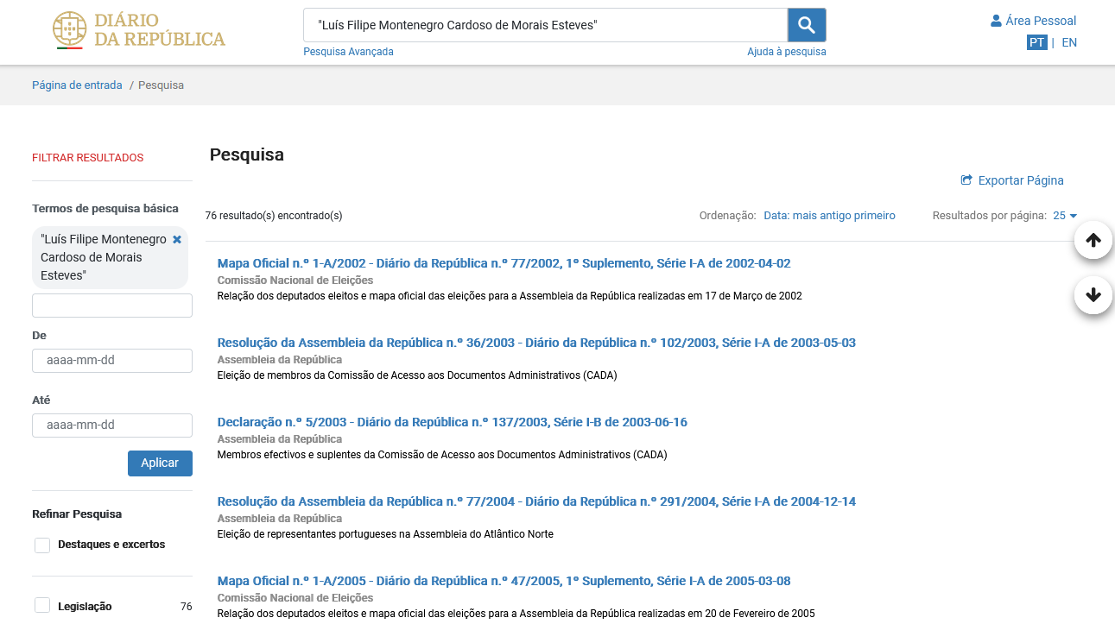

OPOSEC
OSINT
PRIVATE BUSINESS, PUBLIC FALLOUT
Diário da República Eletrónico
Page 13
Notes:
This slide presents information from the 'Diário da República Eletrónico,' a key publication for legal and governmental announcements. It serves as a reminder of the importance of official records in OSINT, as they can provide verified information about individuals and organizations involved in public affairs. This context is essential for understanding the legitimacy of the data being analyzed.

Slide 14
OPOSEC
OSINT
PRIVATE BUSINESS, PUBLIC FALLOUT
Companies
SP&M, Sociedade de Advogados, RL
NIF – 510445020 Cargo – Partner 50% Share –
Luimonteago, Lda
NIF – 510347070 Cargo – Partner 95% Share – 4.750€
Oliveiras Gold de Portugal, Lda
NIF – 510172466 Cargo – Partner 25% Share – 1.200€
Grupo Ferpinta, SA
NIF – 501756710 Cargo – Chairman of the General Meeting
Radio Popular - Eletrodomésticos, SA
NIF – 500674205 Cargo – Chairman of the General Meeting
Page 14
Hint: Companies, business partners, clients, ...
Notes:
Here, we list several companies associated with Luís Montenegro, emphasizing the importance of corporate connections in OSINT investigations. Understanding the relationships between individuals and their business interests can uncover potential conflicts of interest and hidden agendas. The hint encourages the audience to consider how these connections can lead to further inquiries.

Slide 15
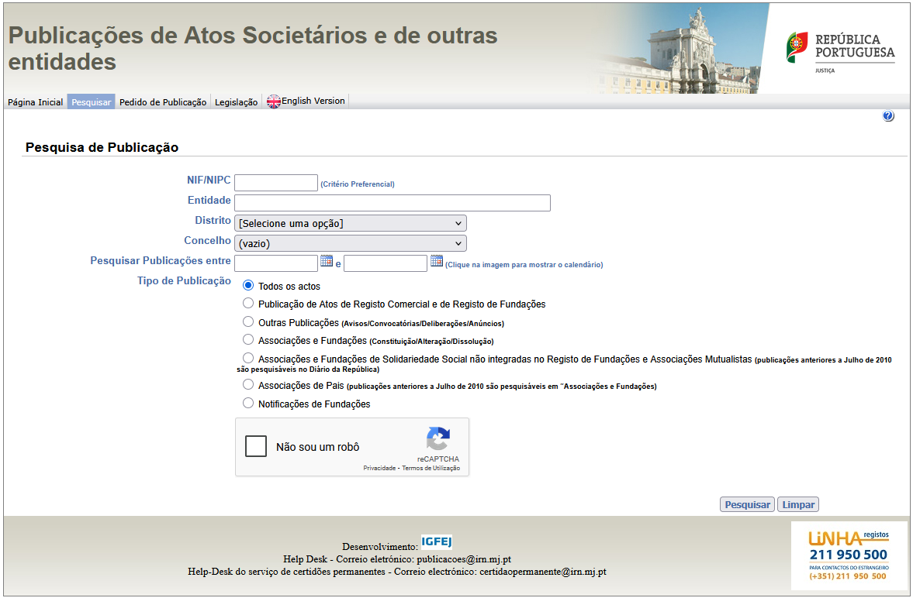

OPOSEC
OSINT
PRIVATE BUSINESS, PUBLIC FALLOUT
Ministério da Justiça – Publicação de Atos Societários
Page 15
Notes:
This slide focuses on the Ministry of Justice and its role in publishing corporate acts. It highlights the significance of legal documentation in OSINT, as these records can provide insights into the operations and affiliations of various entities. This information is crucial for building a comprehensive picture of the political landscape and the individuals within it.

Slide 16
OPOSEC
OSINT
PRIVATE BUSINESS, PUBLIC FALLOUT
SP&M, Sociedade de Advogados, RL - 510445020
?
Page 16
Notes:
Continuing with the focus on SP&M, this slide provides specific details about the law firm associated with Luís Montenegro. Understanding the structure and ownership of such firms can reveal important connections and influence within the legal and political spheres. This context is vital for the audience to appreciate the implications of these relationships in the broader investigation.

Slide 17
OPOSEC
OSINT
PRIVATE BUSINESS, PUBLIC FALLOUT
Status
Name: Luís Montenegro
Full Name: Luís Filipe Montenegro Cardoso de Morais Esteves
NIF: 205910254
Birth: 16/02/1973 - Porto
Marital Status:
Married - Carla Maria Rodrigues Neto Montenegro
Comunhão de Adquiridos
2 children
Address:
Urbanização do Formal, nº 15
4500 - 669 Silvalde - Espinho
Education:
Law graduate - Universidade Católica Portuguesa - 1999
Post-graduate degree in Personal Data Protection - INSEAD
Advanced Management Programme - INSEAD
Previous Job:
Lawyer – Founder and Partner of SP&M law firm - Porto (50%)
Chairman of the General Meeting of the Ferpinta Group
Chairman of the General Meeting of Rádio Popular
Oliveiras Gold de Portugal, Lda (25%) - Bragança
Luimonteago, Lda (95%) - Barcelos
Politician:
Member and Chairman of the Espinho Municipal Assembly and Councillor
Member of Parliament in 2002, 2005, 2009, 2011, and 2015 (16 years)
President of the PSD Parliamentary Group from 2011 to 2017
Leader of the Social Democrats (PSD) since 28 May 2022
Page 17
Hint: Adress is “unique”
Notes:
This slide reiterates key personal information about Luís Montenegro, including his marital status and address. Such details can be significant in OSINT, as they may lead to uncovering additional connections or insights into an individual's life. The hint emphasizes the uniqueness of the address, suggesting that it may be a focal point for further investigation.

Slide 18
OPOSEC
OSINT
PRIVATE BUSINESS, PUBLIC FALLOUT
SP&M, Sociedade de Advogados, RL - 510445020
Site einforma (link)
NIPC: 510445020
Name: SOUSA PINHEIRO & MARQUES - SOCIEDADE DE ADVOGADOS, SP, RL
Previous Names: SOUSA PINHEIRO & MONTENEGRO - SOCIEDADE DE ADVOGADOS, SP, RL
Website: https://spm-advogados.com/
DUNS:
Adress: PRAÇA BOM SUCESSO, 74/90 3º ESCRITÓRIO 7 – 4150-146 PORTO
Telefone:
Email:
CAE: 69101 - Atividades jurídicas, exceto dos cartórios notariais
Page 18
Hint: Adress is “unique”. Other companies on same address?
Notes:
Here, we revisit the SP&M law firm, providing additional context about its operations and previous names. This information is essential for understanding the firm's history and its potential influence on political matters. The hint encourages the audience to consider the implications of shared addresses among companies, which can indicate deeper connections.

Slide 19
OPOSEC
OSINT
PRIVATE BUSINESS, PUBLIC FALLOUT
SP&M, Sociedade de Advogados, RL - 510445020
SP&M (link)
Sócios: Paulo Sousa Pinheiro
WaybackMachine: (link)
Email: lmontenegro@spm-advogados.com
Advogado (cédula profissional n.º 44944P) – Inactivo (portal ordem dos advogados)
Deputado na Assembleia Metropolitana do Porto
Page 19
Hint: Wayback everything
Notes:
This slide continues to explore the SP&M law firm, focusing on its partners and their roles. By examining the individuals involved, we can gain insights into the firm's influence and connections within the political landscape. The hint about using archival tools like the Wayback Machine suggests a proactive approach to uncovering historical data that may be relevant to the investigation.

Slide 20
OPOSEC
OSINT
PRIVATE BUSINESS, PUBLIC FALLOUT
Status
Name: Luís Montenegro
Full Name: Luís Filipe Montenegro Cardoso de Morais Esteves
NIF: 205910254
Birth: 16/02/1973 - Porto
Marital Status:
Married - Carla Maria Rodrigues Neto Montenegro
Comunhão de Adquiridos
2 children
Address:
Urbanização do Formal, nº 15
4500 - 669 Silvalde - Espinho
Email: lmontenegro@spm-advogados.com
Education:
Law graduate - Universidade Católica Portuguesa - 1999
Post-graduate degree in Personal Data Protection - INSEAD
Advanced Management Programme - INSEAD
Previous Job:
Lawyer - 44944P
Lawyer – Founder and Partner of SP&M law firm - Porto (50%)
Chairman of the General Meeting of the Ferpinta Group
Chairman of the General Meeting of Rádio Popular
Oliveiras Gold de Portugal, Lda (25%) - Bragança
Luimonteago, Lda (95%) - Barcelos
Politician:
Member and Chairman of the Espinho Municipal Assembly and Councillor
Member of Parliament in 2002, 2005, 2009, 2011, and 2015 (16 years)
President of the PSD Parliamentary Group from 2011 to 2017
Leader of the Social Democrats (PSD) since 28 May 2022
Page 20
Notes:
Returning to Luís Montenegro, this slide provides a comprehensive overview of his personal and professional background. The detailed information allows the audience to understand his influence and connections within the political sphere. The hint encourages a thorough examination of all available data, reinforcing the investigative nature of OSINT.

Slide 21
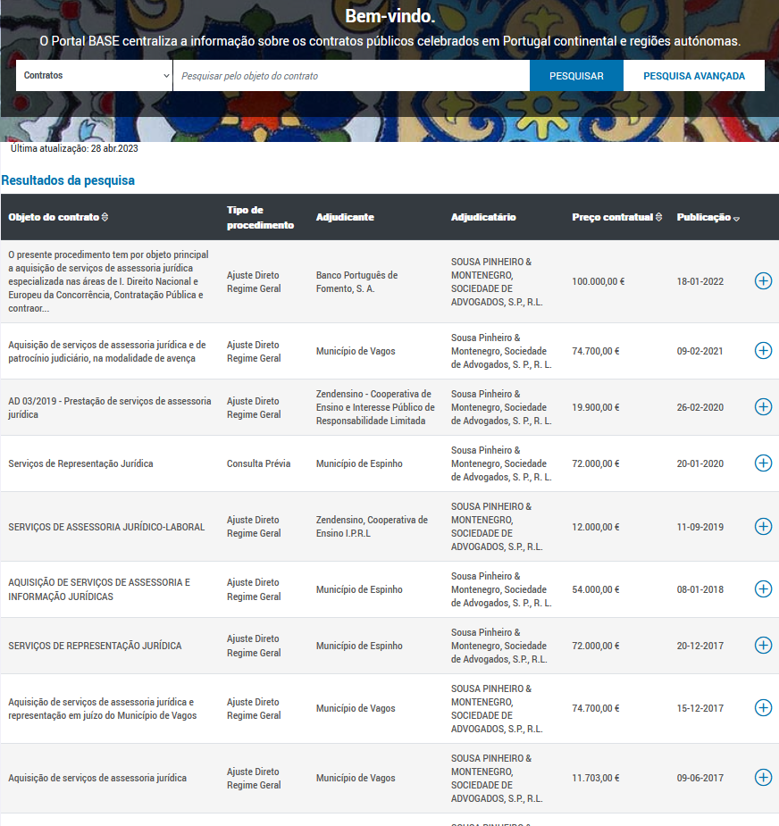
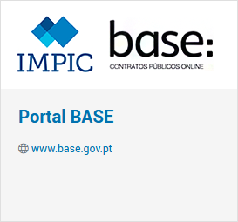
OPOSEC
OSINT
PRIVATE BUSINESS, PUBLIC FALLOUT
Portal BASE
Page 21
Notes:
This slide introduces the 'Portal BASE,' a crucial resource for accessing public contract information. Understanding how to navigate these databases is essential for conducting effective OSINT investigations. This resource can provide insights into government spending and relationships between public officials and private entities.

Slide 22
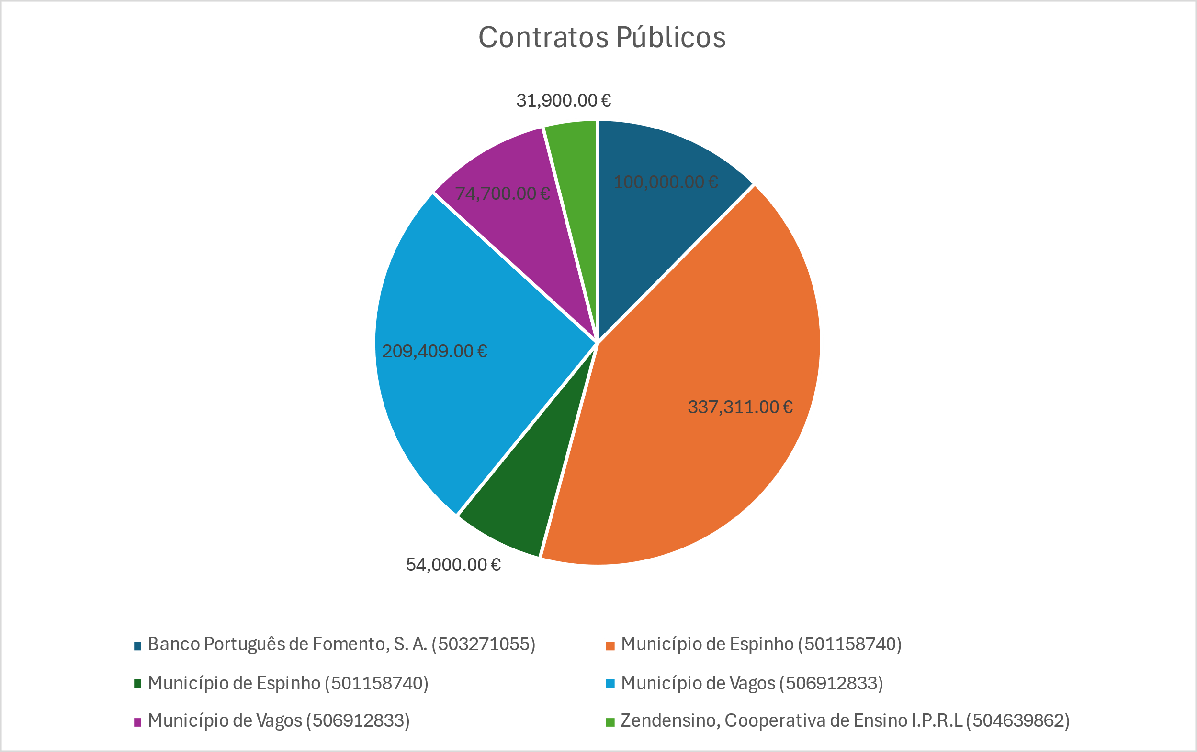
OPOSEC
OSINT
PRIVATE BUSINESS, PUBLIC FALLOUT
SP&M, Sociedade de Advogados, RL - 510445020
Contratos Públicos
Banco Português do Fomento
2022 – 1 contrato – 100.000€
Município de Espinho
2014/2019 – 7 contratos – 337.311 €
Município de Vagos
2015/2021 – 5 contratos – 209.409 €
Zendensino
2018/2020 – 2 contratos – 31.900 €
Total 807.320€
Page 22
Notes:
Here, we present a summary of public contracts associated with various entities, including monetary values. This data is vital for understanding the financial relationships between government and private businesses. Highlighting these contracts underscores the potential for conflicts of interest and the importance of transparency in public dealings.

Slide 23
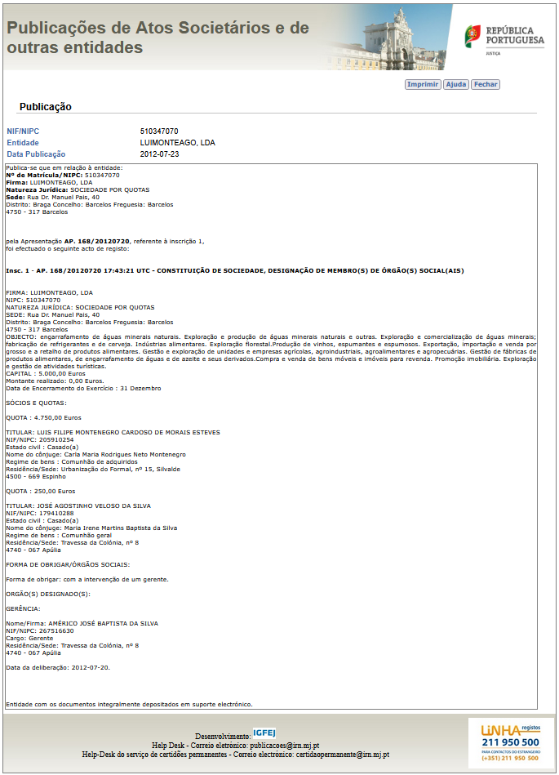
OPOSEC
OSINT
PRIVATE BUSINESS, PUBLIC FALLOUT
Luimonteago, Lda - 510347070
Page 23
Notes:
This slide focuses on Luimonteago, Lda, providing essential information about the company. Understanding the operations and affiliations of such entities is crucial for OSINT investigations, as they can reveal connections to public officials and their interests. This context helps the audience appreciate the broader implications of corporate relationships in political scandals.

Slide 24
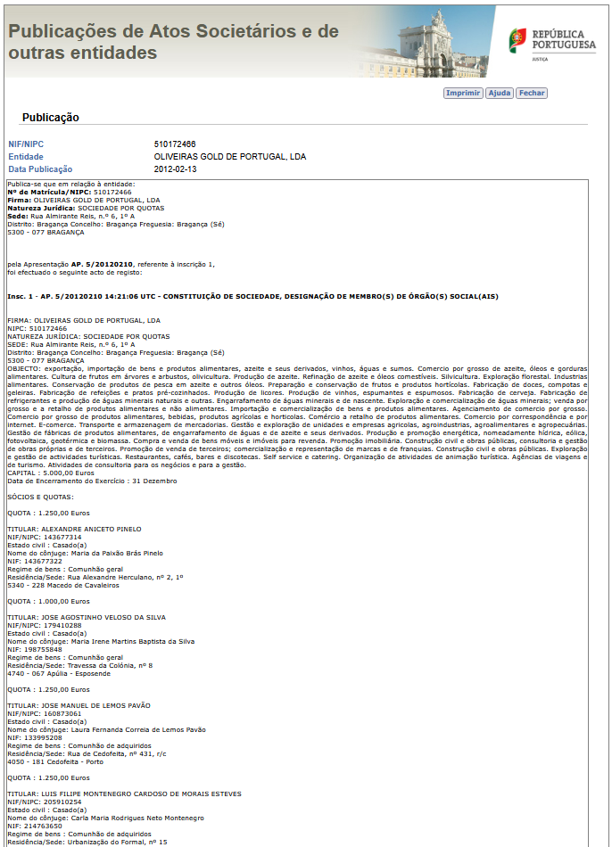
OPOSEC
OSINT
PRIVATE BUSINESS, PUBLIC FALLOUT
Oliveiras Gold de Portugal, Lda - 510172466
Page 24
Notes:
Continuing with Oliveiras Gold de Portugal, this slide provides key details about the company. As with previous slides, understanding the connections between businesses and public officials is essential for uncovering potential conflicts of interest. This information reinforces the importance of thorough investigations in OSINT.

Slide 25
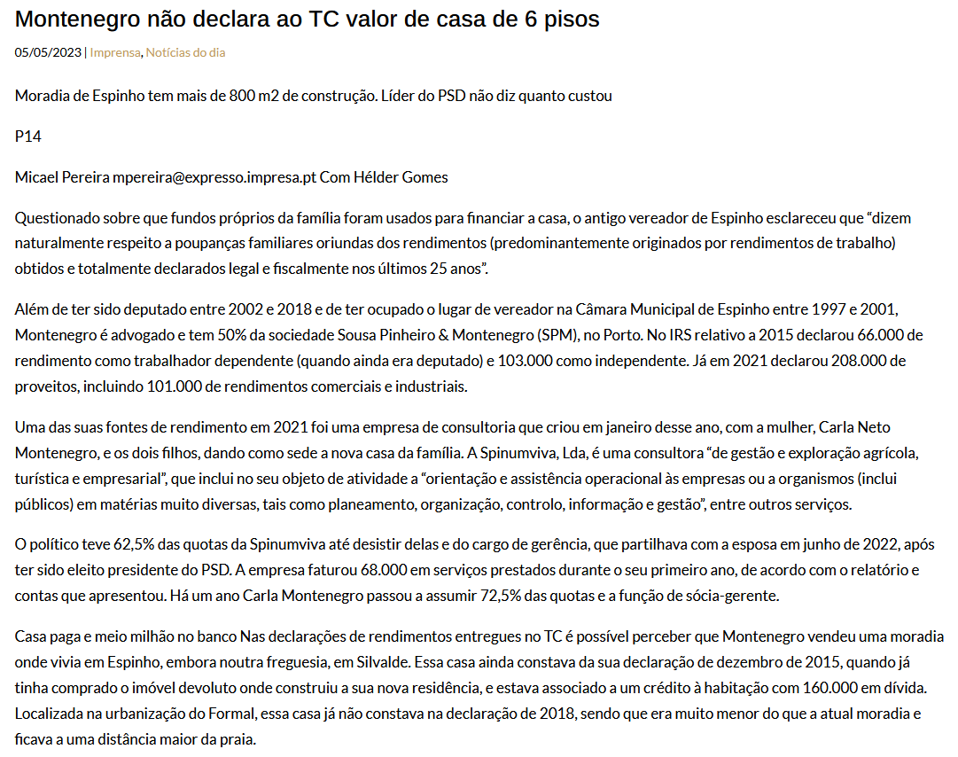
OPOSEC
OSINT
PRIVATE BUSINESS, PUBLIC FALLOUT
Semanário Expresso
Page 25
Notes:
This slide references Semanário Expresso, a publication that may provide additional context or insights into the ongoing investigation. Highlighting media sources emphasizes the role of journalism in uncovering public scandals and the importance of cross-referencing information from various outlets in OSINT.

Slide 26
OPOSEC
OSINT
PRIVATE BUSINESS, PUBLIC FALLOUT
Companies
SP&M, Sociedade de Advogados, RL
NIF – 510445020 Cargo – Partner 50% Share –
Luimonteago, Lda
NIF – 510347070 Cargo – Partner 95% Share – 4.750€
Oliveiras Gold de Portugal, Lda
NIF – 510172466 Cargo – Partner 25% Share – 1.200€
Grupo Ferpinta, SA
NIF – 501756710 Cargo – Chairman of the General Meeting
Radio Popular - Eletrodomésticos, SA
NIF – 500674205 Cargo – Chairman of the General Meeting
Spinumviva, Lda
NIF – 516195174 Cargo – Partner 62.5% Share – 3.750€
Page 26
Hint: Companies, business partners, clients, ...
Notes:
Here, we list several companies associated with Luís Montenegro, emphasizing the importance of corporate connections in OSINT investigations. Understanding the relationships between individuals and their business interests can uncover potential conflicts of interest and hidden agendas. The hint encourages the audience to consider how these connections can lead to further inquiries.

Slide 27
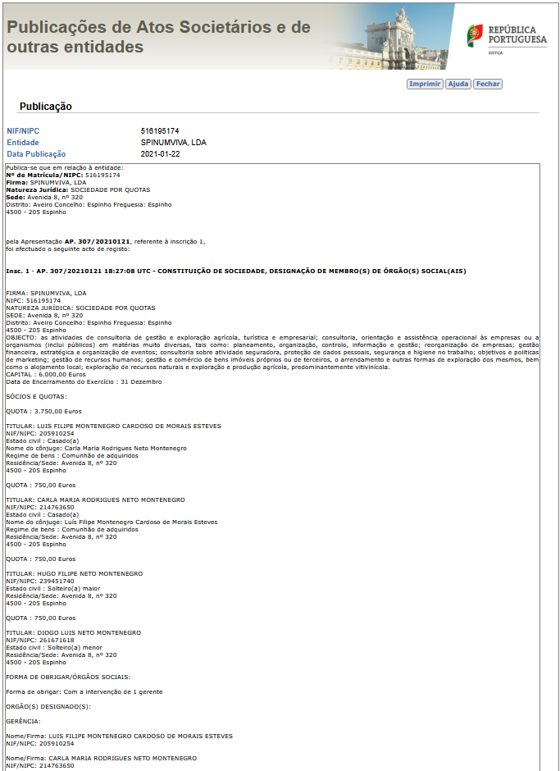
OPOSEC
OSINT
PRIVATE BUSINESS, PUBLIC FALLOUT
Spinumviva, Lda - 516195174
Page 27
Notes:
This slide focuses on Spinumviva, Lda, providing essential information about the company. As with previous slides, understanding the operations and affiliations of such entities is crucial for OSINT investigations, as they can reveal connections to public officials and their interests. This context helps the audience appreciate the broader implications of corporate relationships in political scandals.

Slide 28
OPOSEC
OSINT
PRIVATE BUSINESS, PUBLIC FALLOUT
Status
Name: Luís Montenegro
Full Name: Luís Filipe Montenegro Cardoso de Morais Esteves
NIF: 205910254
Birth: 16/02/1973 - Porto
Marital Status:
Married - Carla Maria Rodrigues Neto Montenegro
Comunhão de Adquiridos
Hugo Filipe Neto Montenegro
Diogo Luís Neto Montenegro
Address:
Avenida 8, nº 320
4500 - 205 Espinho
Email: lmontenegro@spm-advogados.com
Education:
Law graduate - Universidade Católica Portuguesa - 1999
Post-graduate degree in Personal Data Protection - INSEAD
Advanced Management Programme - INSEAD
Previous Job:
Lawyer - 44944P
Lawyer – Founder and Partner of SP&M law firm - Porto (50%)
Chairman of the General Meeting of the Ferpinta Group
Chairman of the General Meeting of Rádio Popular
Oliveiras Gold de Portugal, Lda (25%) - Bragança
Luimonteago, Lda (95%) - Barcelos
Politician:
Member and Chairman of the Espinho Municipal Assembly and Councillor
Member of Parliament in 2002, 2005, 2009, 2011, and 2015 (16 years)
President of the PSD Parliamentary Group from 2011 to 2017
Leader of the Social Democrats (PSD) since 28 May 2022
Page 28
Notes:
Returning to Spinumviva, this slide provides a timeline of significant events related to the company. Understanding these milestones can help the audience grasp the company's evolution and its potential connections to public officials. The hint encourages a proactive approach to gathering information, emphasizing the importance of thorough investigations in OSINT.

Slide 29
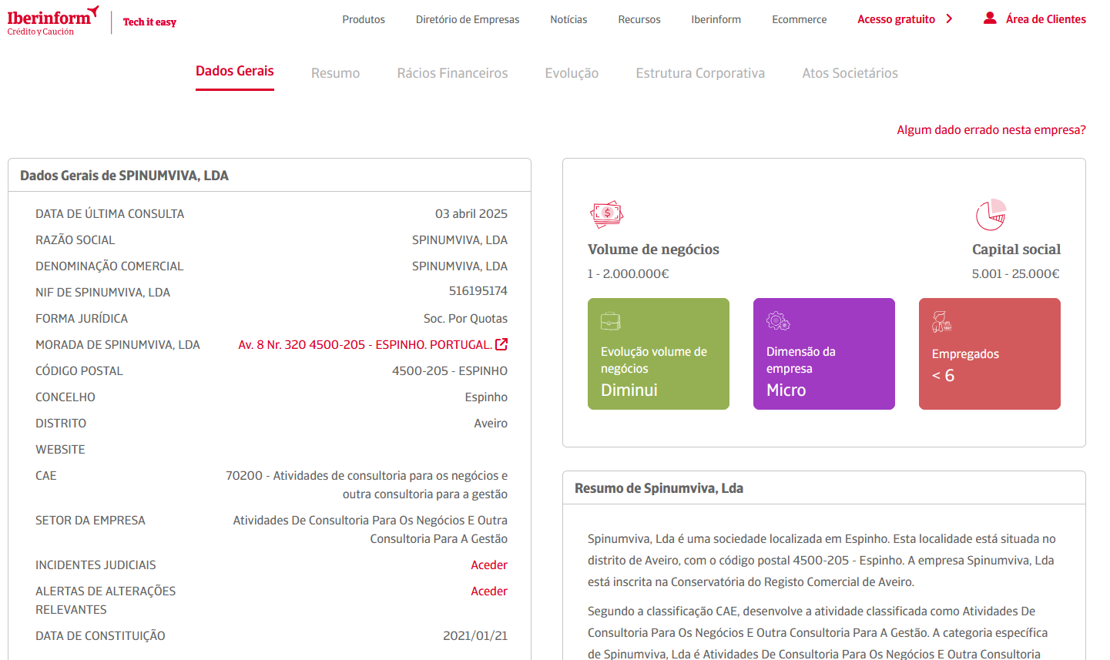
OPOSEC
OSINT
PRIVATE BUSINESS, PUBLIC FALLOUT
Spinumviva, Lda - 516195174
Page 29
Notes:
Generated by Copilot Here, we revisit Spinumviva, summarizing key details about the company. This slide serves as a reminder of the various entities involved and their potential influence on political matters. The audience is encouraged to consider how these relationships can lead to further inquiries, reinforcing the investigative nature of OSINT. ______

Slide 30
OPOSEC
OSINT
PRIVATE BUSINESS, PUBLIC FALLOUT
Status
Name: Luís Montenegro
Full Name: Luís Filipe Montenegro Cardoso de Morais Esteves
NIF: 205910254
Birth: 16/02/1973 - Porto
Marital Status:
Married - Carla Maria Rodrigues Neto Montenegro
Comunhão de Adquiridos
Hugo Filipe Neto Montenegro - 9251XXXXX
Diogo Luís Neto Montenegro
Address:
Avenida 8, nº 320
4500 - 205 Espinho
Email:
lmontenegro@spm-advogados.com
spinumviva@gmail.com
Phone:
9685XXXXX
Education:
Law graduate - Universidade Católica Portuguesa - 1999
Post-graduate degree in Personal Data Protection - INSEAD
Advanced Management Programme - INSEAD
Previous Job:
Lawyer - 44944P
Lawyer – Founder and Partner of SP&M law firm - Porto (50%)
Chairman of the General Meeting of the Ferpinta Group
Chairman of the General Meeting of Rádio Popular
Oliveiras Gold de Portugal, Lda (25%) - Bragança
Luimonteago, Lda (95%) - Barcelos
Politician:
Member and Chairman of the Espinho Municipal Assembly and Councillor
Member of Parliament in 2002, 2005, 2009, 2011, and 2015 (16 years)
President of the PSD Parliamentary Group from 2011 to 2017
Leader of the Social Democrats (PSD) since 28 May 2022
Page 30
Hint: Automate tasks
Notes:
Generated by Copilot This slide provides a comprehensive overview of Luís Montenegro's personal and professional background, including contact information. Understanding his connections and influence is crucial for the audience to appreciate the broader implications of the investigation. The hint encourages the audience to consider how automation can streamline the process of gathering and analyzing information. ______

Slide 31

OPOSEC
OSINT
PRIVATE BUSINESS, PUBLIC FALLOUT
Portal SICAE
CAE | Código de Actividade Económica
70200 | (702) Actividades de consultoria para os negócios e a gestão
74992 | Outras atividades de consultoria, cientificas, técnicas e similares, diversas
01210 | Viticultura
68200 | Arrendamento e exploração de bens imobiliários próprios ou em locação
68110 | Compra e venda de bens imobiliários
11021 | Produção de vinhos comuns e licorosos
Page 31
Notes:
This slide continues to detail Spinumviva, providing additional context about its operations. The timeline of events reinforces the importance of understanding the company's history and its potential influence on political matters. This information is crucial for building a comprehensive picture of the relationships at play in the investigation.

Slide 32
OPOSEC
OSINT
PRIVATE BUSINESS, PUBLIC FALLOUT
Timeline
Jan/2020
LM lost election for PSD president
Mar/2025
Carla resigns from
SPINUNVIVA management
Mar/2022
Son Hugo added as SPINUMVIVA manager
Jul/2022
LM becomes PSD president
Set/2022
LM resigns from
SPINUNVIVA management
Jun/2023
Son Diogo added as SPINUMVIVA manager
Nov/2023
António Costa resigns as PM
Apr/2024
LM Prime Minister
Jan/2021
Register SPINUMVIVA with wife and sons
LM and wife managers
Mar/2025
Collapse of the government
Page 32
Notes:
This slide continues to detail Spinumviva, providing additional context about its operations. The timeline of events reinforces the importance of understanding the company's history and its potential influence on political matters. This information is crucial for building a comprehensive picture of the relationships at play in the investigation.

Slide 33
OPOSEC
OSINT
PRIVATE BUSINESS, PUBLIC FALLOUT
Conclusion
This case exemplifies OSINT’s power to transform scattered public data—news, registries, social media—into actionable intelligence. By following these steps, anyone with internet access could have pieced together the scandal that toppled Portugal’s government in 2025.
The fallout underscores a broader lesson: in an era of transparency, private business can’t escape public scrutiny when OSINT is in play.
Page 33
Notes:
Generated by Copilot In conclusion, this slide emphasizes the transformative power of OSINT in turning scattered public data into actionable intelligence. The case study serves as a reminder of the importance of transparency and accountability in both public and private sectors. The audience is encouraged to reflect on the broader implications of OSINT in today's information-driven world. ______

Slide 34
OPOSEC
OSINT
PRIVATE BUSINESS, PUBLIC FALLOUT
Portal | Portal do Governo
 | Membros do Governo (link) Primeiro-Ministro (link) Redes sociais
Portal | Publicações de Atos Societários
 | Consultar e pesquisar todas as publicações (link)
https://www.doutorfinancas.pt/empresas/como-obter-informacoes-sobre-uma-empresa/ https://transparencia.gov.pt/ Pesquisa de bens penhorados – não oficial (link) Pesquisa de bens penhorados – não oficial (link) https://geneall.net/ https://www.einforma.pt/ https://www.iberinform.pt https://www.racius.com https://www.rigorbiz.pt/ https://www.emailondeck.com/ https://temp-mail.org/ https://www.playmakerstats.com/ https://www.pai.pt/
Portal | Portal da Assembleia da República
 | Deputados em funções (link) Informação Pessoal (link) Registo de interesses (link) Participação em empresas (link) Dados Abertos (link)
Portal
 | Pesquisa (link) Site alternativo – DRE Tretas (link)
Portal | Portal BASE
 | O Portal BASE centraliza a informação sobre os contratos públicos (link) Contratos (link) Anúncios (link) Entidades (link) Empresas e Pessoas Indicadores (link)
Lista de subvenções e benefícios públicos e de doações (IGF) (link) Lista pública de execuções (link) Venda de Bens Penhorados em Processos Executivos (link) Lista de devedores na Segurança Social (link) Listas de Devedores na Autoridade Tributária e Aduaneira (link)
Page 34
Notes:
Generated by Copilot This slide presents various portals and resources that are essential for conducting OSINT investigations. By providing links to government and public databases, the audience is equipped with practical tools to further their understanding and application of OSINT techniques. This resourcefulness is key to effective intelligence gathering. ______

Slide 35


OPOSEC
OSINT
PRIVATE BUSINESS, PUBLIC FALLOUT
FUTURE
PUBLIC DATABASE
AUTOMATION
DATA ANALYTICS
Map the Key Individuals and Entities
Trace Financial Connections
Transparency on all politicians/ public serveants.
Page 35
Notes:
Generated by Copilot Looking to the future, this slide outlines the potential for public databases, automation, and data analytics in enhancing OSINT capabilities. By mapping key individuals and tracing financial connections, we can improve transparency and accountability in public service. This forward-thinking approach encourages the audience to consider how technology can aid in uncovering hidden truths. ______
Database of companies
Multiple sources
Search by persons
Network visualization
Companies
Persons

Slide 36
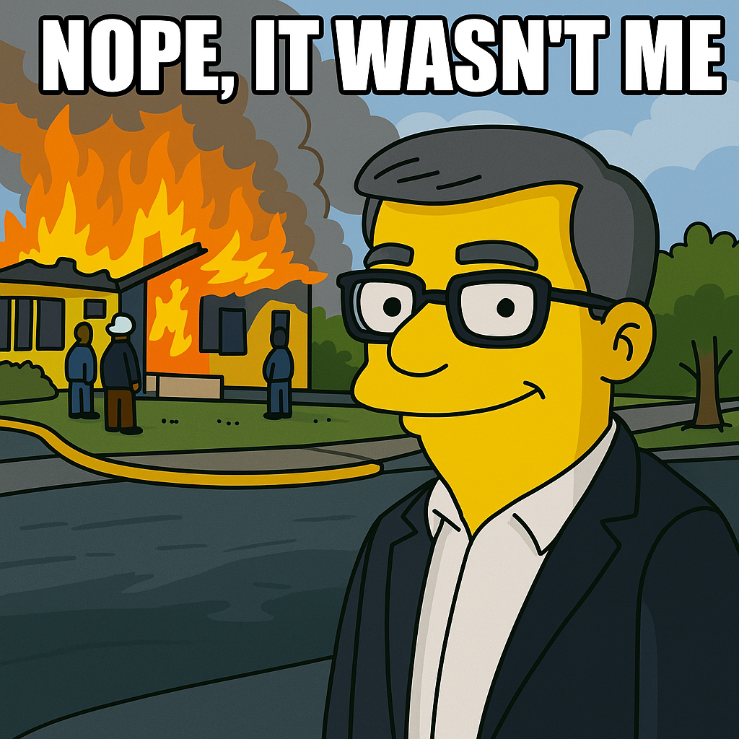
OPOSEC
OSINT
PRIVATE BUSINESS, PUBLIC FALLOUT
THANK YOU
Q&A
Page 36
Notes:
Generated by Copilot As we wrap up, this slide invites questions and discussions, fostering engagement with the audience. It's an opportunity to clarify any points and delve deeper into specific areas of interest. Encouraging dialogue reinforces the collaborative nature of learning and sharing insights in the field of OSINT. ______

